Slide 1

WEB SCRAPING TO GAIN COMPANY INSIGHTS
Aissiou Ikram 28/2/2023

Slide 2
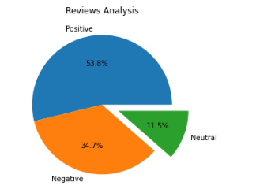
INSIGHTS FROM CUSTOMER REVIEWS
From cleaning 1000 reviews given by the customers, we obtained
Positive Reviews - 538
Negative Reviews - 347
Neutral Reviews – 115

